Slide 1

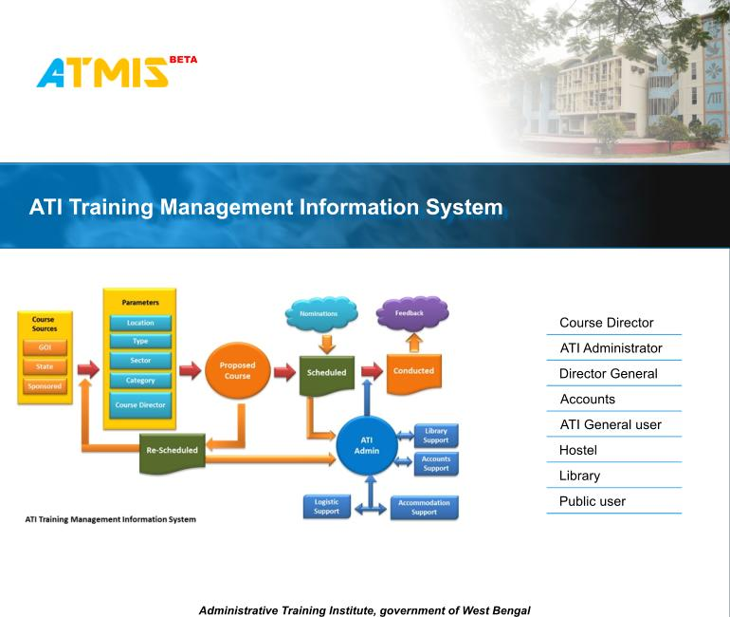

ATI Training Management Information System -
www.atiwb.gov.in/courseadmin
ATI, West Bengal
Track5: Use of Technology to bring innovation in Training

Slide 2

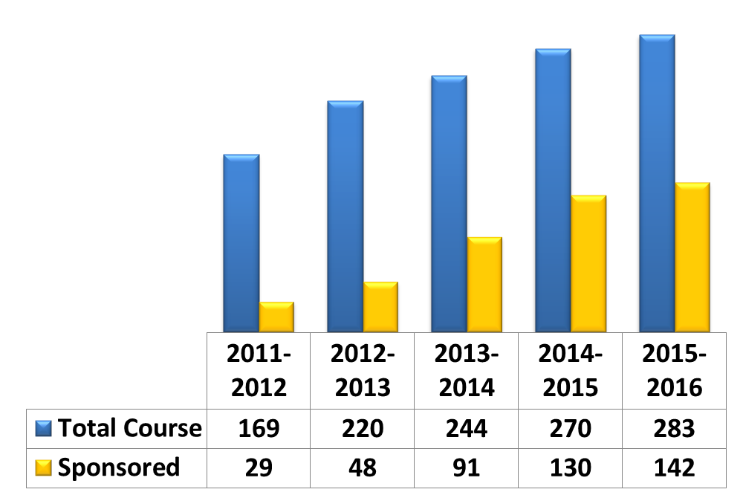
Background
Printed Training Calendar – Training programmes conducted differ from printed training calendar, published in the beginning of the year
During 2015 -16, 283 training programmes ware conducted at ATI for 9279 trainees
Increased no of training programmes over the last five years
Percentage of sponsored training programmes (Excluding DoPT) in total training programmes, increased from 17% to 50% over last five years
In the beginning of the financial year the no. of sponsored programmes could not be anticipated; new sponsored training programmes included in the training calendar through out the year , based on demand from sponsoring agencies
Change in Training Mix - Sponsored Training Programmes (Excluding DoPT) were increasing, causing uncertainty in scheduling of training
Data Maintenance - Training related information used to be kept at multiple points including 19 Regional Training Centres
Lack of Public Interface - Limited information to the trainees & other stakeholders
Supervision - Monitoring of Training Programmes were difficult due to lack of timely information

Slide 3
Identify the Needs
Analyze Current Process
Design revised processes
Implement revised processes
Objectives of the initiative
Improvement in training Management
Increase Effectiveness in resource utilization
Better Public Interface
Improve Trainees’ Satisfaction
Better Information sharing with the employees
Efficient Monitoring System
Need based Dynamic Training Calendar
Process
re-engineering
through
ATMIS

Slide 4
Course
Sources
Nominations
Feedback
GOI
Proposed Course
State
Scheduled
Conducted
Sponsored
Approved
DG-ATI
Allocation of Hostel and Class room
Parameters
Not Approved
Feasibility Check Pass
Accounts
Location
Type
Feasibility Check Fail
Course Director
ATI Admin
Library
Sector
Proposal for Course
/ Re-Schedule
/Cancel
Category
Feasibility Check
Hostel
Course Director
Accommodation Support
Logistic Support

Slide 5
Roles and Responsibilities in ATMIS
Course Director – Propose New Courses, Activate Proposed Course as Scheduled Course, Nomination Activate or Deactivate, Nomination Response, Proposed No. of Candidate for Course, Course End Report, Re-Schedule or Cancel Course
ATI Administrator - Class Room and Accommodation Allocation, Administrative Approval for Course (Feasibility Check), Setup of Classroom, Category, Accommodation, Location, Sector, Course Director, and General User
Director General – Course Approval, Administrative and Accounts Rights, Changing of Parameter, Remarks
Accounts – Fund Received Status, Remarks
ATI General User – Detail report, Summary Report, Current Course report etc.
Hostel – Room Allocation to trainees , Check-out from Hostel
Library – Book Issue and Return
Public User – Course with Details , nomination and feedback

Slide 6
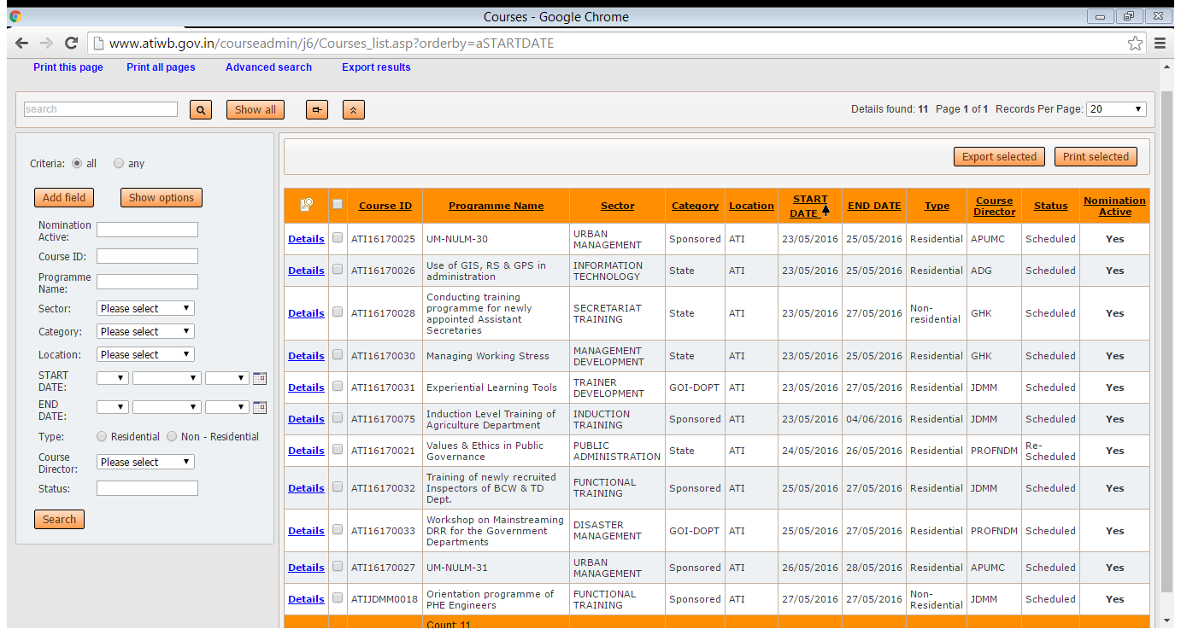
Course view for public user

Slide 7
Key features in ATMIS
Web Based , can be used 24 X 7 from any where
Role based activity
Customized Search option
Customized Sort
Integration with Word, Excel, text format
AJAX control search and pagination
Master Level Customization
Mobile App enabled

Slide 8

Constraints/Challenges Faced
Transfer the functions of training administration process into IT enabled logical platform
Resistance to Change
Awareness of stakeholders
Participants are not used to send online submission for training
Lack of knowledge & skill in operating online software

Slide 9
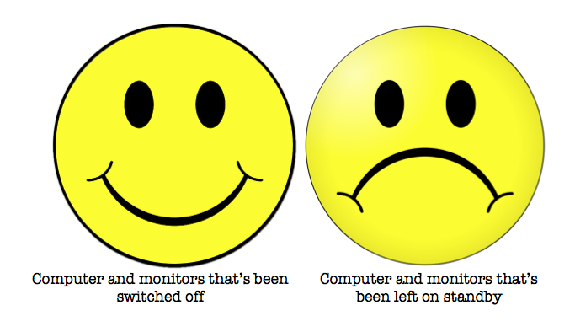
Enabling Factors
Internet and networking throughout the campus, connecting all users
User Friendly Software
Continuous Training of all officers and Staff
Do away of the traditional File System related to Training Management

Slide 10
Impact of ATMIS
Input
Output
Outcome
Impact
Implementation of ATMIS
Dynamic Training Calendar
Scope of adding new course , reschedule and cancel existing course
Improvement in Training Management
Optimal utilization of Resources
Better Monitoring structure for ATI and Sponsoring Agencies
Improved Public Interface
Ensuring Transparency, Accountability & Timeliness in training management and execution

Slide 11
Sustainability Including Critical Factors to Sustain
Involvement of all the senior officers and staffs in the development and implementation.
Continues Monitoring from the top management.
Social
Economic
Environmental
Improved access to information related to training, for Trainees and Sponsoring Agencies.
Sustainable
Done In-house without any external agencies : minimal cost involvement in development, Implementation and Maintenance.

